Slide 1
EEE 363
DC MACHINES
Class Schedule : MW 1:00 PM – 2:40 PM
Instructor : Dr. Shohana Rahman Deeba
Department of Electrical and Computer Engineering
Office: SAC-1010B
Email: shohana.deeba@northsouth.edu
Acknowledgement: Dr. Mithulan Nadarajah
The University of Queensland, Australia

Slide 2

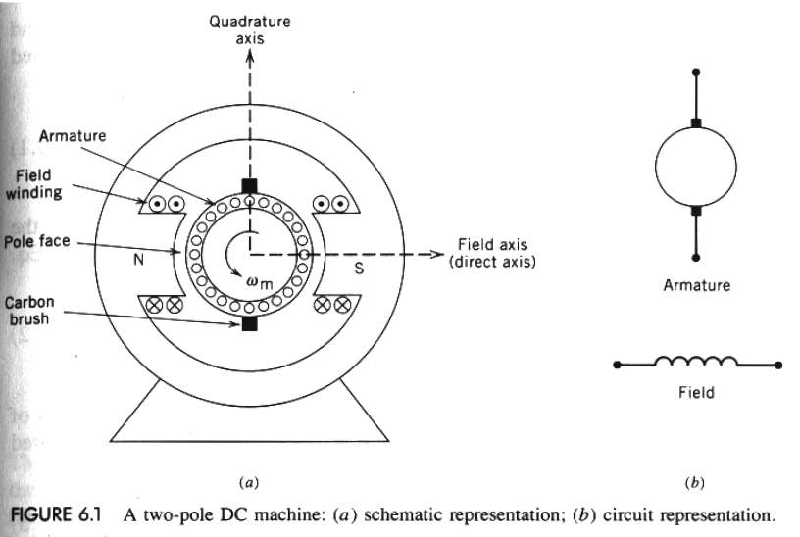
Dr. Shohana Rahman Deeba, Assistant Professor, ECE-NSU

Slide 3

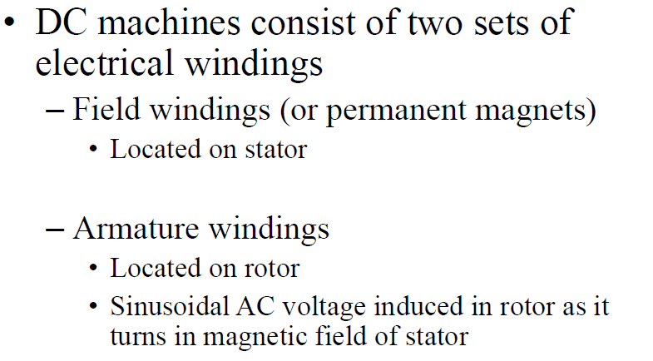
Dr. Shohana Rahman Deeba, Assistant Professor, ECE-NSU

Slide 4
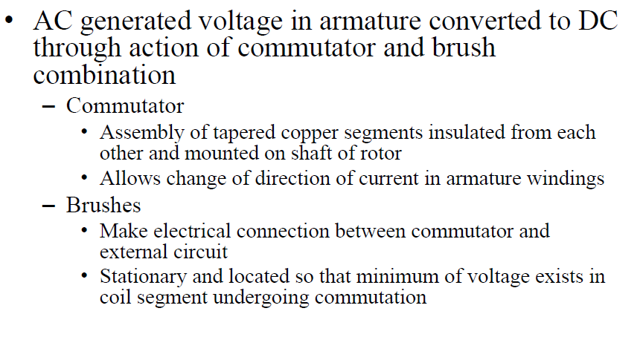
Dr. Shohana Rahman Deeba, Assistant Professor, ECE-NSU

Slide 5
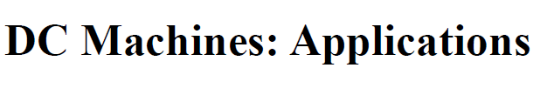
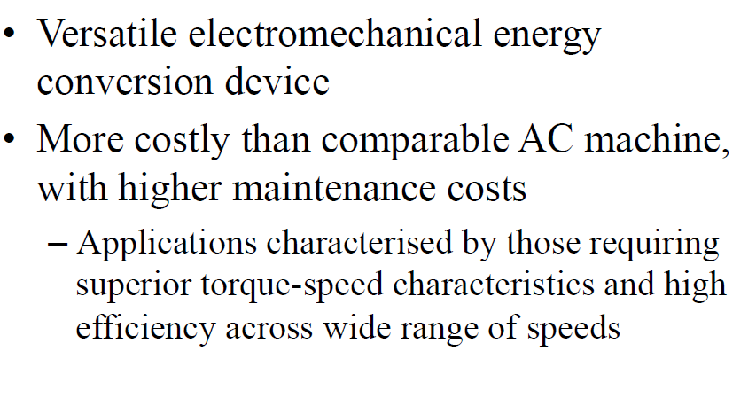

Slide 6
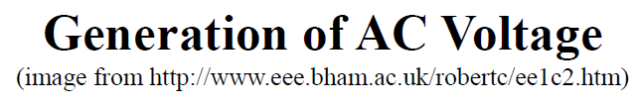
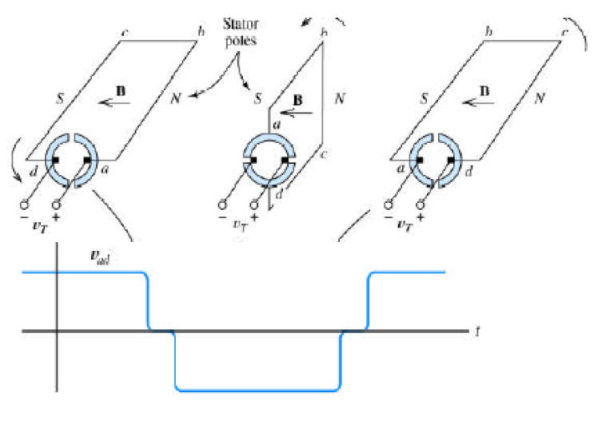

Slide 7
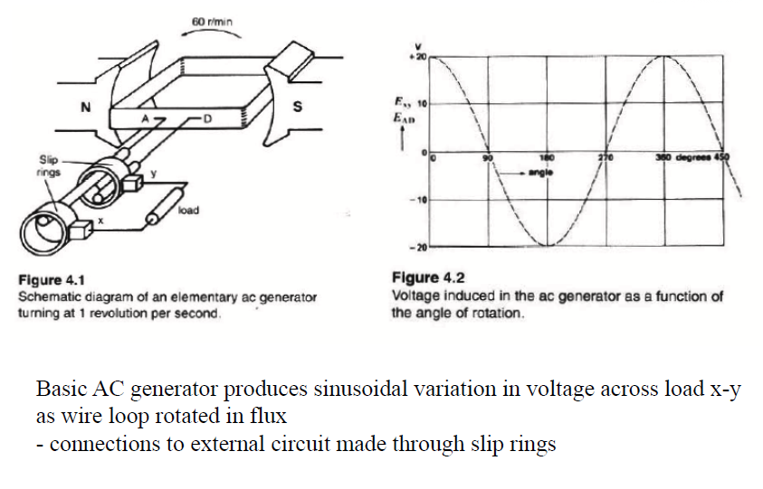

Slide 8
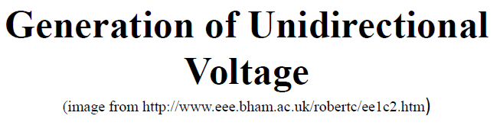
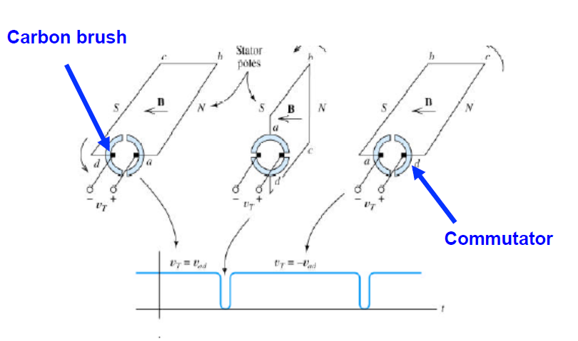

Slide 9
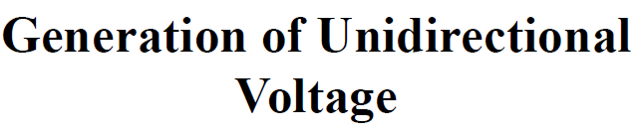
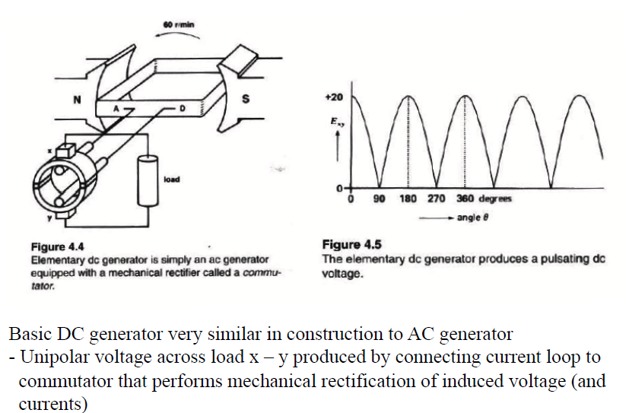

Slide 10
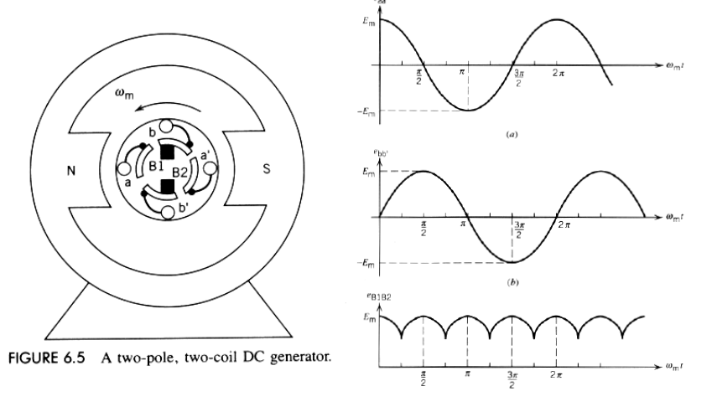

Slide 11
